Slide 1
DESIGN PROJECT-4 EasyWrite
Ryan Junejo
Mariam Mohamed
Pranav Chandrakumar

Slide 2
1 in every 400 Individuals in Canada Suffer From Multiple Sclerosis
Source: MS Society Canada[1]

Slide 3
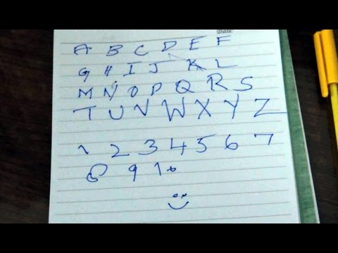
THE PROBLEM
Studies have shown that MS patients have less handwriting rhythm and control than healthy individuals.
Handwriting sample of a person suffering from MS
Source: MS Society of Pakistan [2]

Slide 4
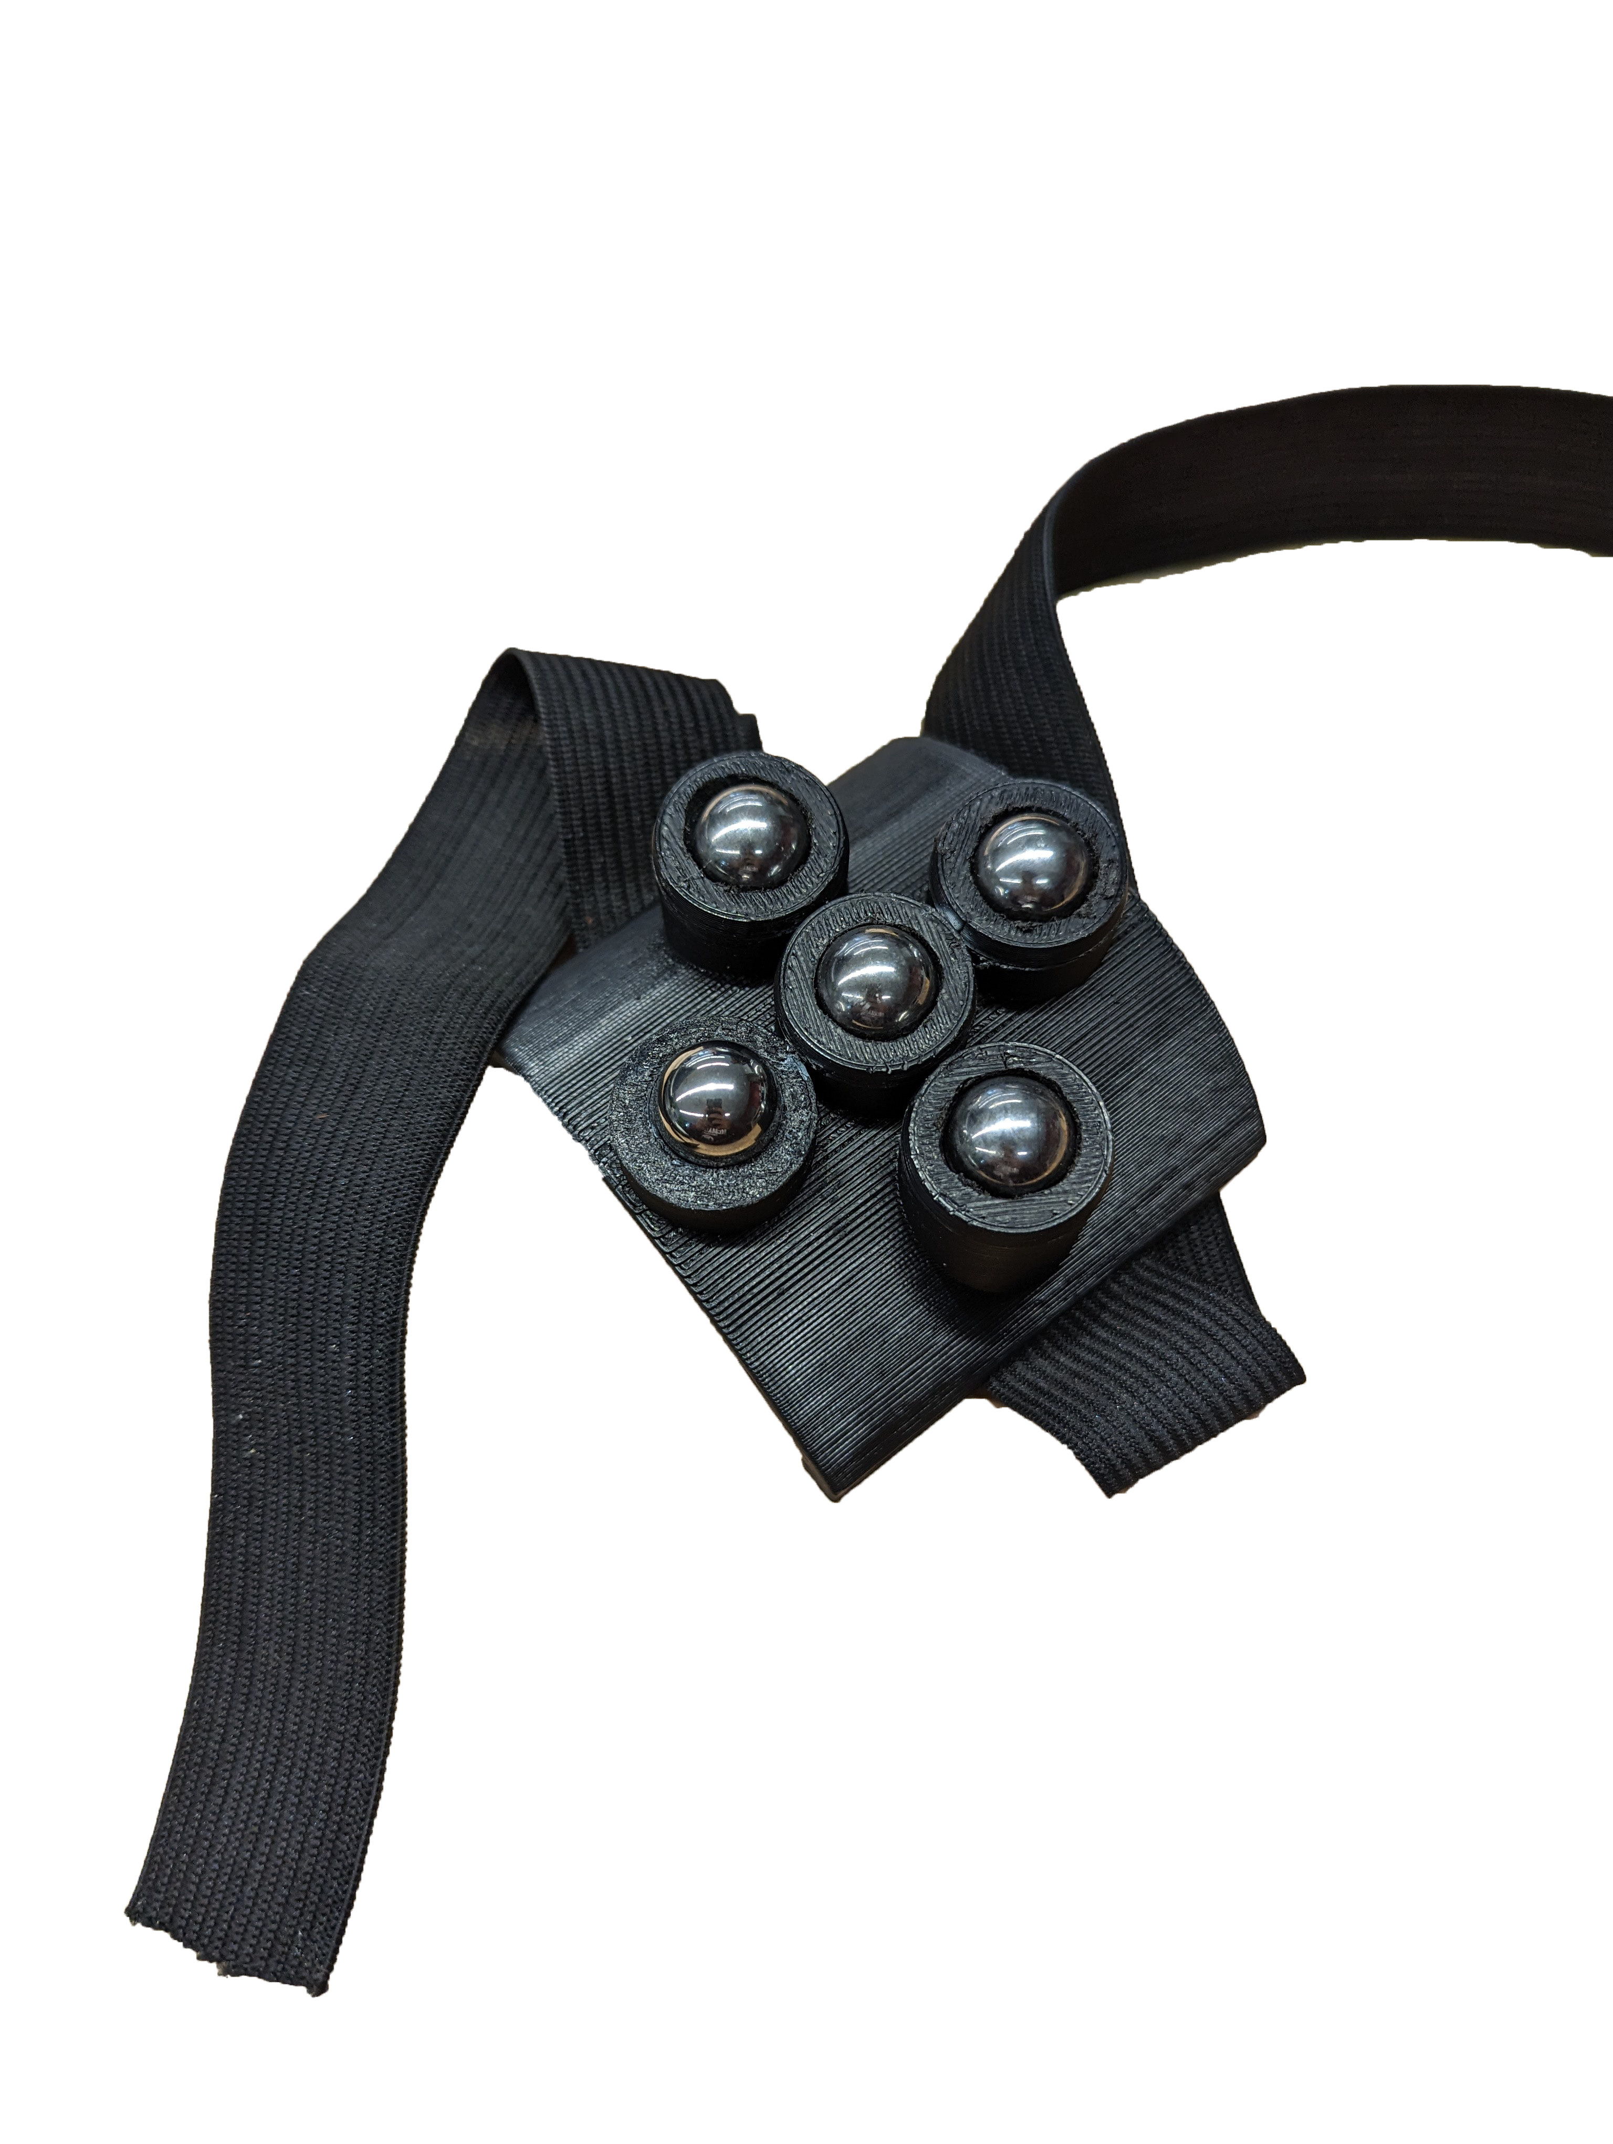
Introducing EasyWrite
A discreet mechanical wrist brace designed to assist MS patients with writing through the use of a gyro system that aids in wrist movement.

Slide 5
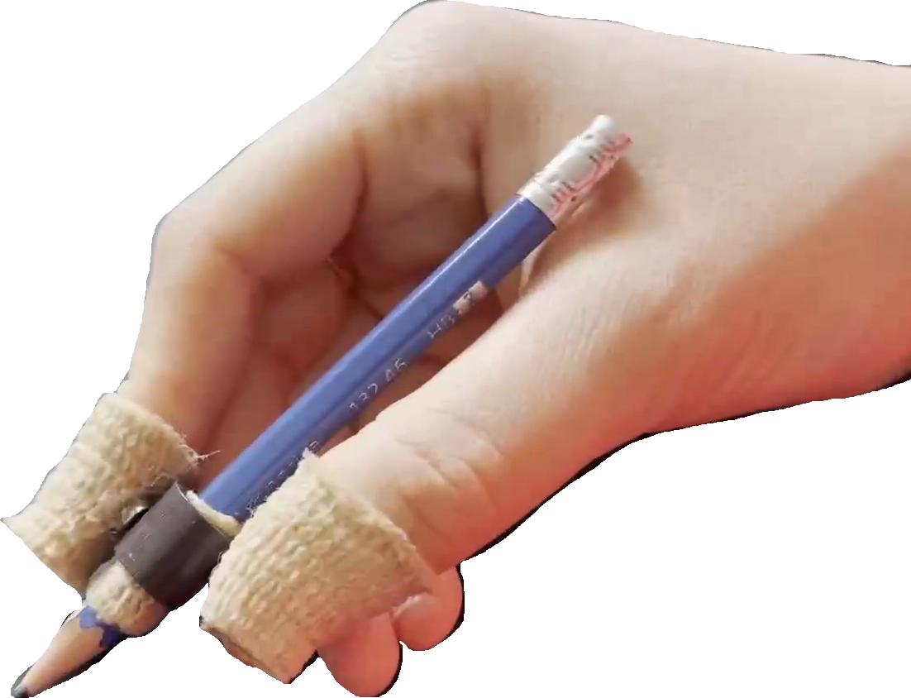
Introducing EasyPen
An add-on to the EasyWrite that aids the user in grip strength of the pencil through the use of magnets

Slide 6
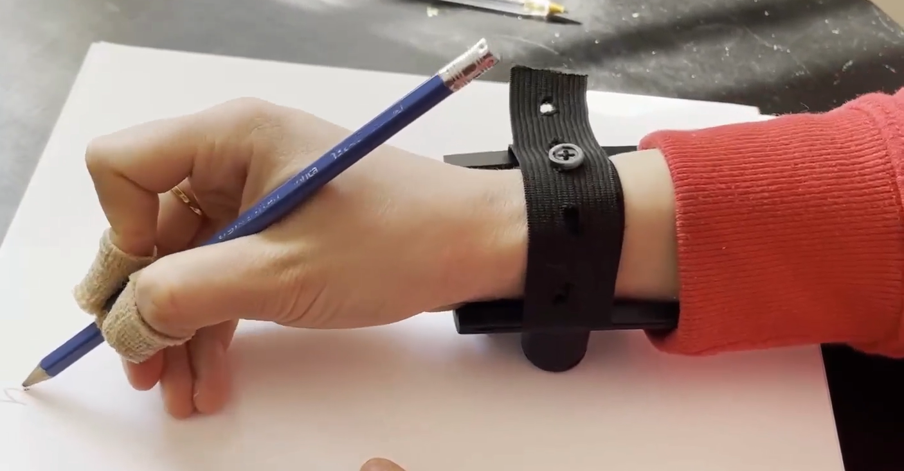
How it works
User slips their wrist into the adjustable strap of EasyWrite.
It facillitates the motion of their wrist in a 360 degree axis.
The accompanied EasyPen allows for easy and comfortable pencil grip.

Slide 7
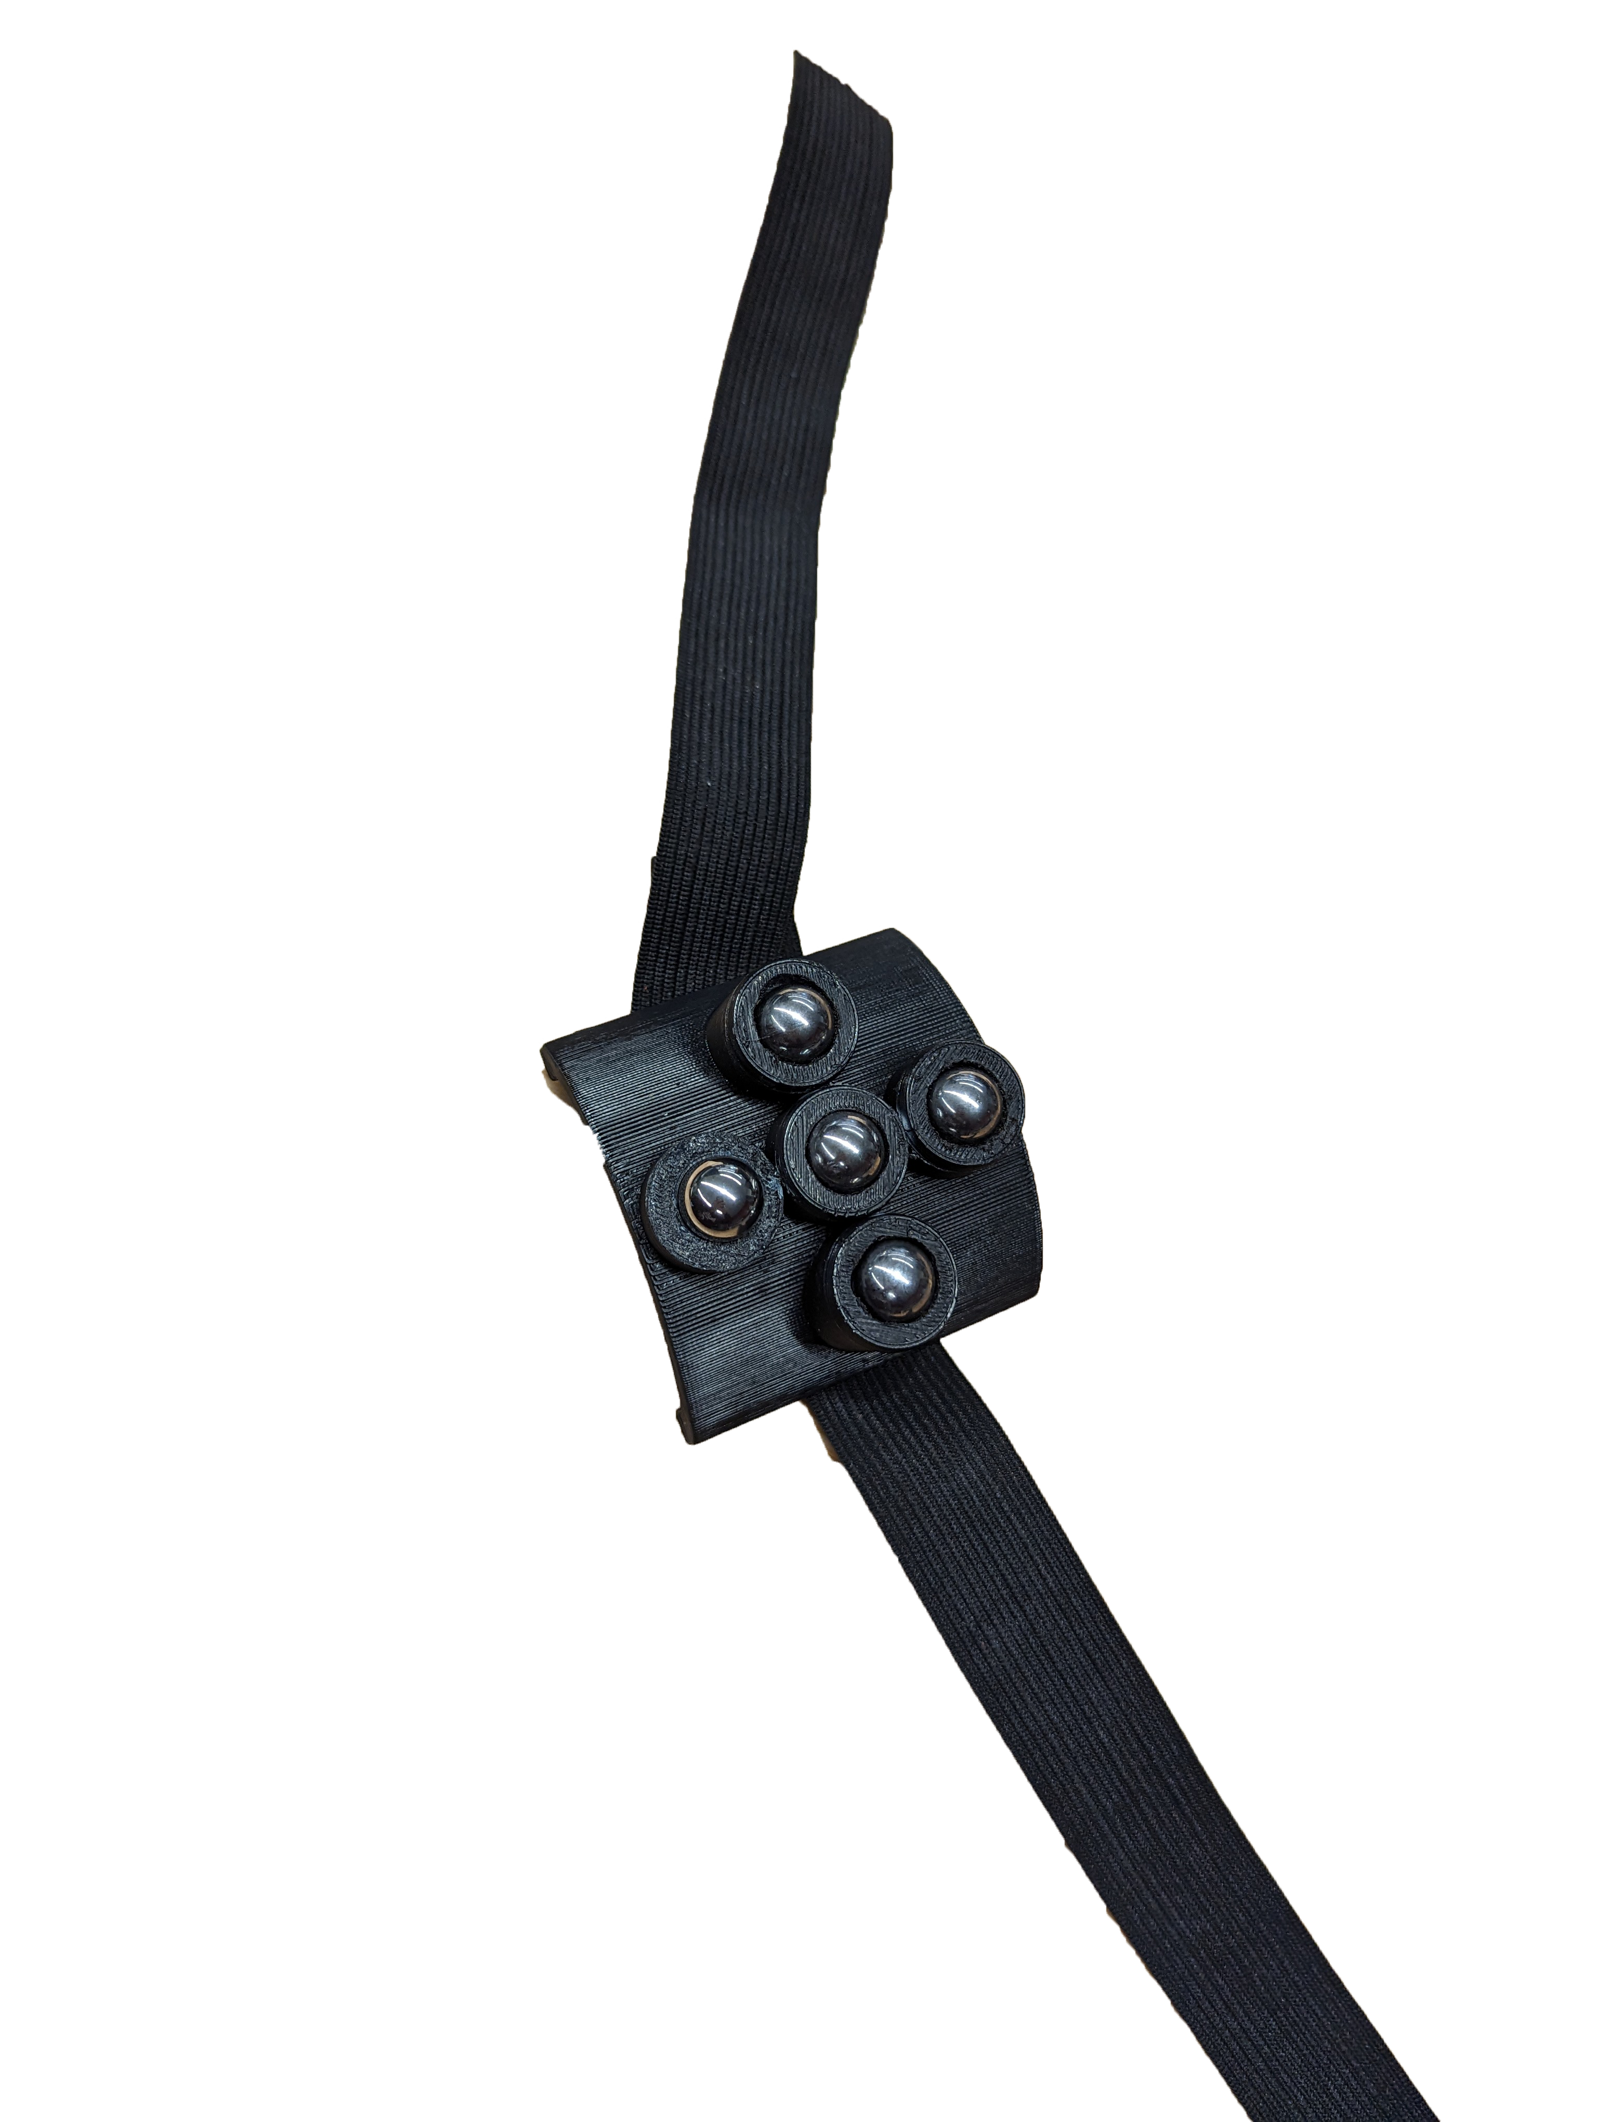
Design Considerations
Chromium Steel Balls
Elastic/ Adjustable Wrist Strap
Smooth and Durable
Flexible and Comfortable
Discreet Modelling
Easy to Remove
Black colour improves discretion: looks like a normal wrist band
Button Clasp system that provides security

Slide 8
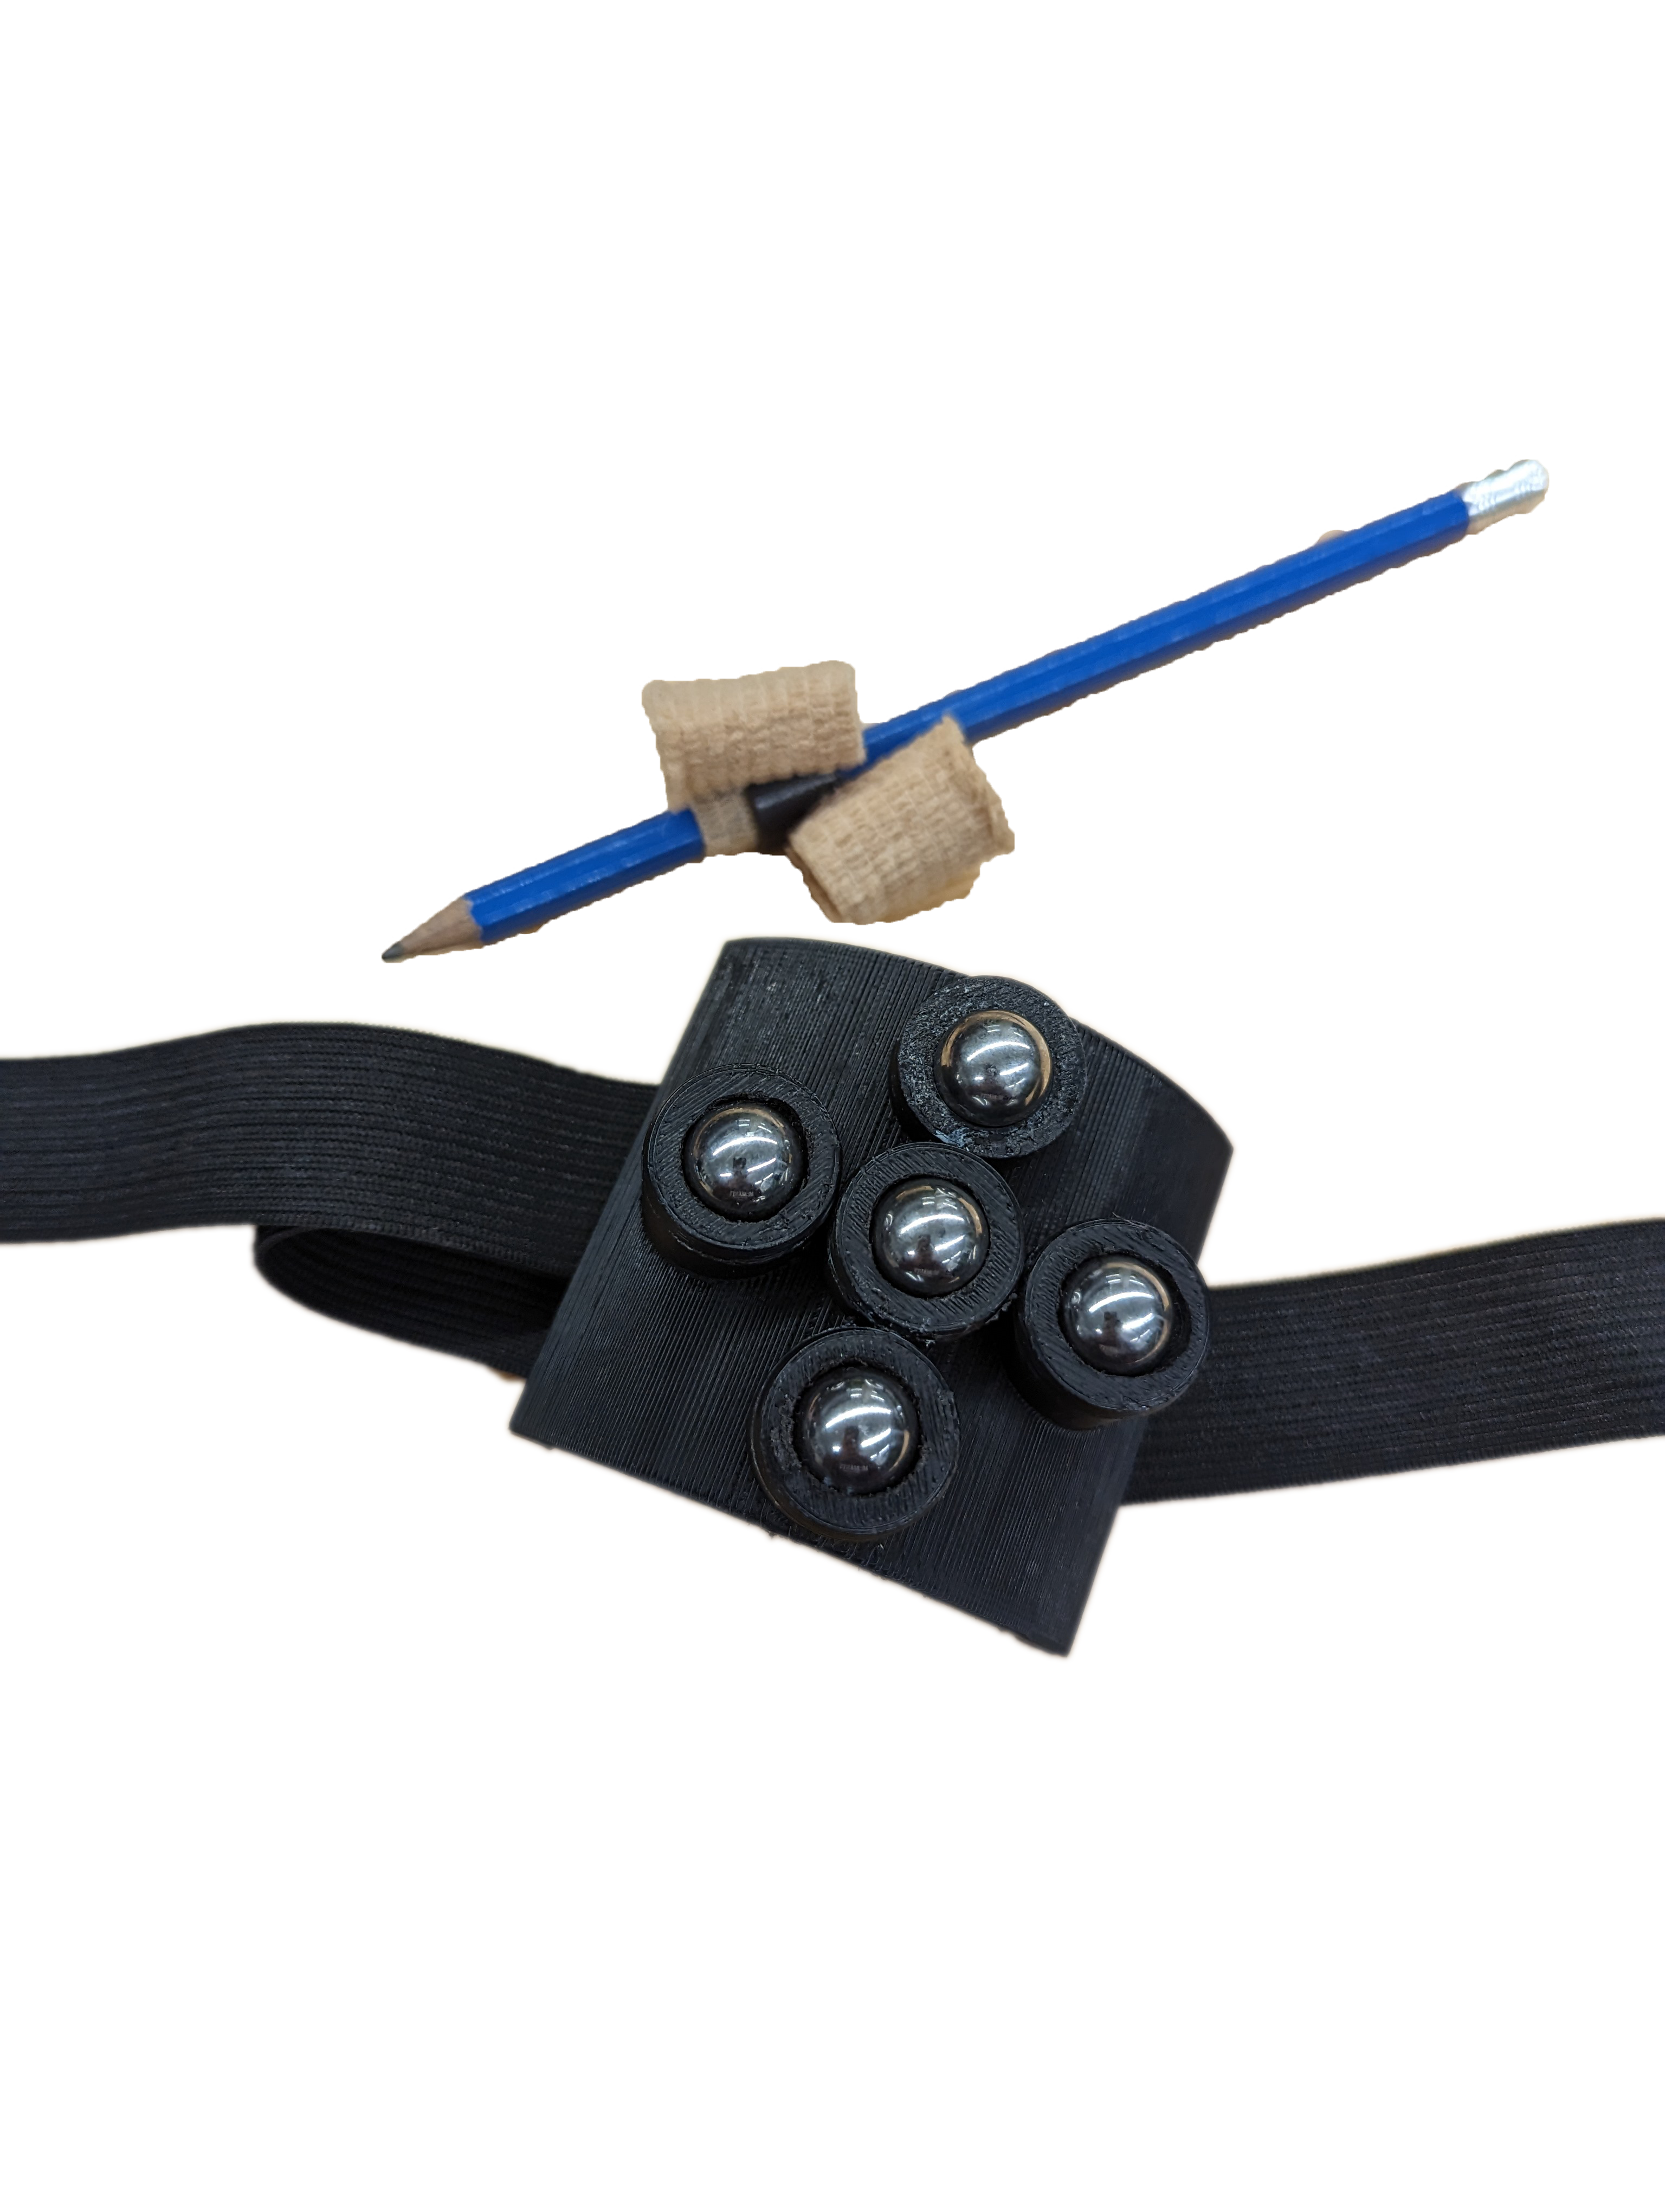
Next Steps...
Modify Magnetic Components
To ensure the utmost discretion of the pencil components
Add Padding
Modularity
For increased comfort in the wrist brace to allow for longer writing periods without discomfort
Current model can only fit a small range of wrist sizes

Slide 9
— Aunt May
“When you help someone, you help everyone.”

Slide 10
References:
[1]: “Latest MS Research News,” Prevalence and incidence of MS in Canada and around the world - MS Society of Canada. [Online]. Available: https://mssociety.ca/research-news/article/prevalence-and-incidence-of-ms-in-canada-and-around-the-world?force_lang=en_CA. [Accessed: 09-Apr-2023].
[2] “Writing problems and MS (multiple sclerosis),” YouTube, 29-Jul-2016. [Online]. Available: https://www.youtube.com/watch?v=Vxvf5OEufFg&ab_channel=SocietyforMultipleSclerosisPatientsinPakistan. [Accessed: 09-Apr-2023].

